Slide 1

Aqara Dimmer Switch H2 US

Slide 2
Content
Product Introduction
Product Installation
Configuration on App
FAQ

Slide 3
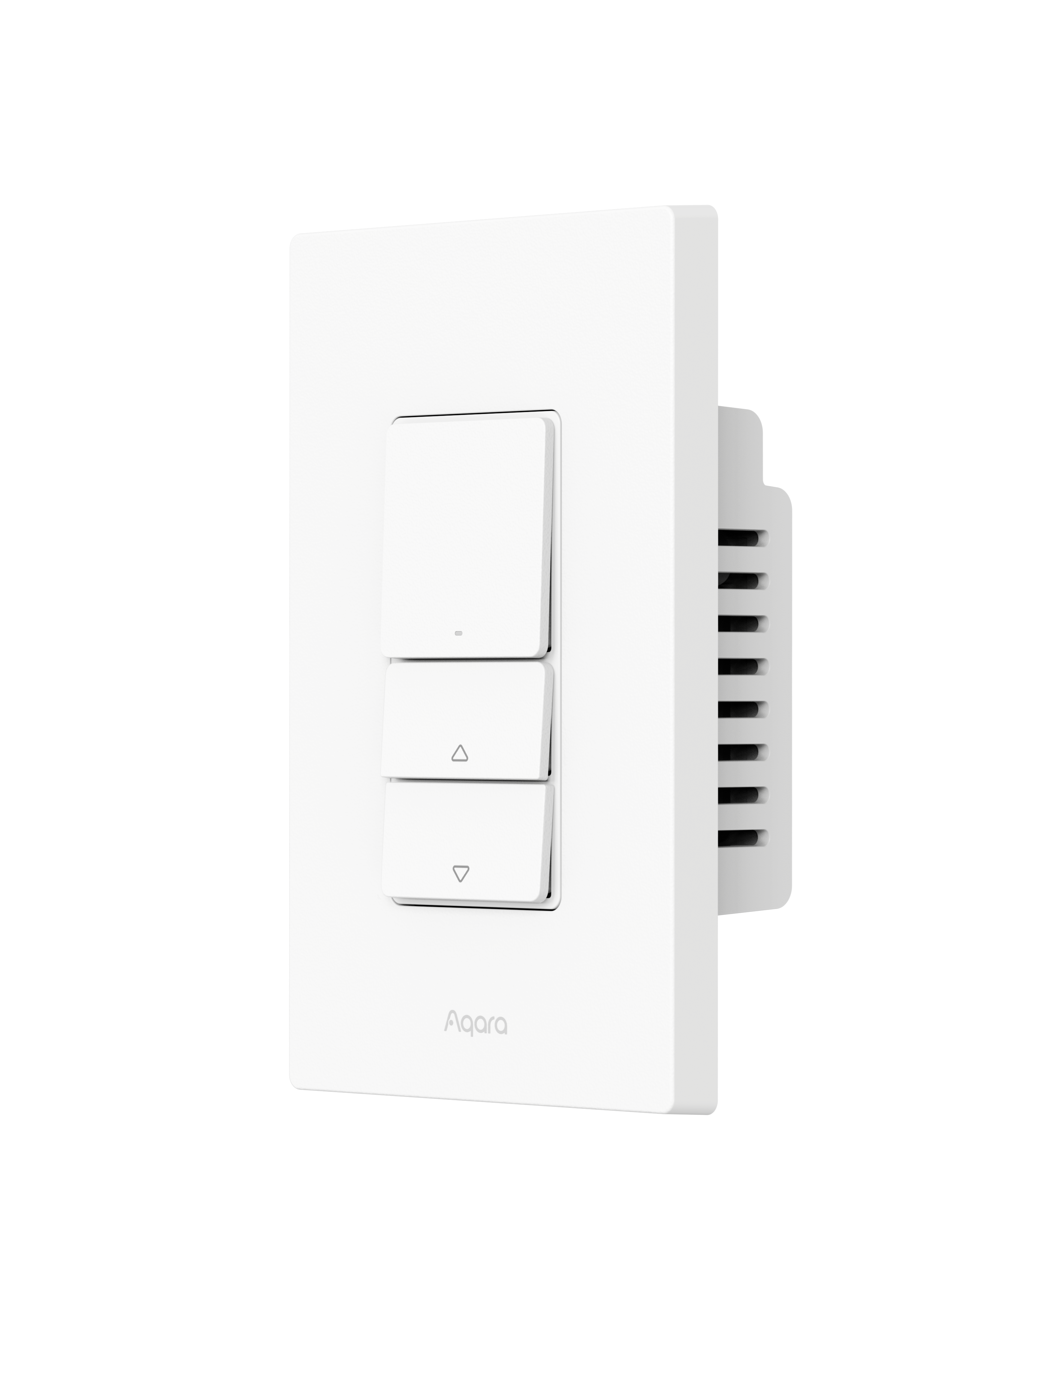
Product Overview
The Aqara Dimmer Switch H2 US is a smart dimming dial based on the Thread & Zigbee wireless communication protocols, supporting both with or without neutral wire modes. It can directly adjust incandescent lamps, dimmable LED lamps, halogen lamps, fluorescent lights, and ELV fixtures, achieving seamless dimming with 1% precision. Users can manually switch between leading and trailing edge dimming modes for better compatibility with various light types. With a compatible hub, the switch enables remote app control, scheduled control, power monitoring, and more advanced automation with other smart devices.
**This product requires a device equipped with Matter Border Router or Zigbee Hub functionality.
Key Product Selling Points:
1% precision seamless dimming with adjustable minimum and maximum brightness levels (minimum brightness adjustable on the device; maximum brightness adjustment requires the Aqara Home app under the Zigbee protocol)
Compatible with halogen lamps, incandescent lamps and dimmable LED and fluorescent lamps, ELV (electronic low voltage transformer)
Supports gang installation
Dual protocols (Thread & Zigbee )
Switch between leading and trailing edge dimming based on load type

Slide 4
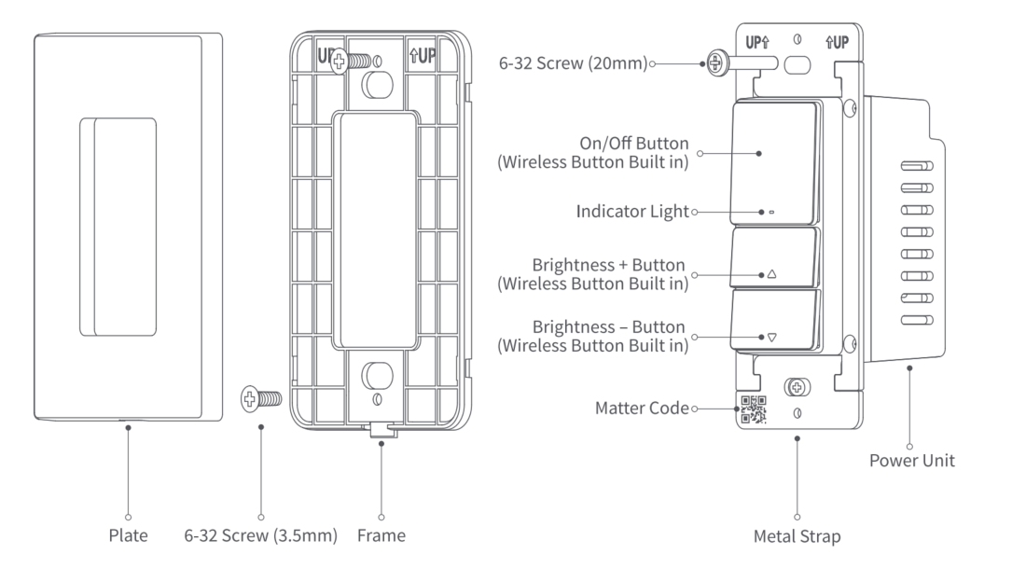
Product Structure

Slide 5


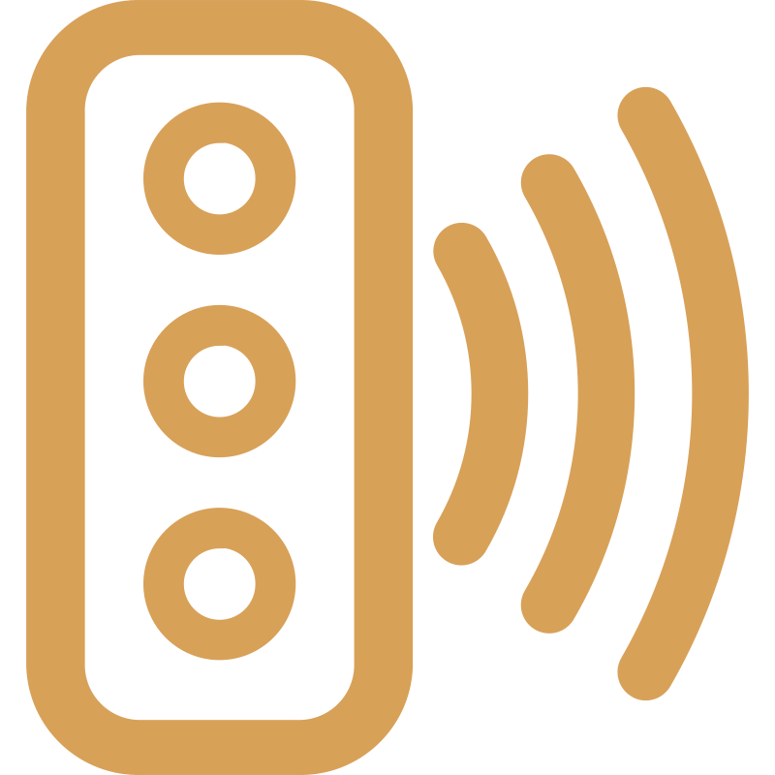



Selling Points
DECORA townhouses
Supports townhouse installation
Comes with wireless switch
Come with 3 wireless switches
Thread & Zigbee
Thread communication protocol, capable of connecting to third-party platforms that support Matter
Power metering
Display load power data via APP
(only supported in with neutral mode)
2-In-1 Neutral
Work with both neutral and no-neutral wiring
Compatible with multiple types of lamps
Supports dimming incandescent lamps, dimmable LED lamps, halogen lamps, fluorescent lamps and ELV lamps
Notes:
1-100%无极调光
自定义亮度

Slide 6
Matter Standard Functions
Currently, all new Matter devices only support standard functions at launch, with other proprietary functions added in later updates.
Feature Module | Feature Item | Matter Feature Description | Remarks
Matter Standard Functions | Binding | supported
 | OTA
 | Reset
 | Factory Reset Settings
 | On\Off |  | Switch, toggle control, power-on status setting
 | Power Measurement |  | Supported only in neutral wire mode
 | Brightness Adjustment |  | Does not support color temperature and RGB value adjustment
 | Wireless Switch |  | Only supports rapid single click
 | Routing Function |  | Only supported in neutral wire mode
 | Status Reporting |  | on/off, level control, wireless switch single-click events, vendor info.
 | Find Device |  | In-app device location search; device provides feedback to indicate its location (sound, light, vibration)

Slide 7
Aqara Exclusive Functions
Currently, all new Matter devices only support standard functions at launch, with other proprietary functions added in later updates.
Feature Module | Feature Item | Matter Feature Description | Remarks
Matter Standard Functions | Front and rear edge manual switching in single and neutral wire mode | supported | Local function Interactive mode: Click 5 times to enter the phase selection mode. After entering this mode, the yellow light flashes three times slowly. Red means the current mode is the front phase. Click toggle. Green means the current mode is the back phase. Long press to save and exit. It will automatically exit after timeout. The timeout period is 1 minute.
 | minimum brightness settings |  | Local function Interaction mode: Double-click the switch button within 3 seconds to enter the lowest brightness configuration mode. After adjusting the button to reach the desired brightness, click to save the setting. The setting success indicator flashes green twice slowly.
 | Light switch transition time |  | Functional requirements: The transition time for turning on/off the light can be configured Default state: The default time for turning on/off the light is 500ms; Configurable range: 0-10.5s
 | Power off memory |  | Aqara Home is supported, but third-party ecosystems are not supported yet
 | Overcurrent, overheat protection |  | Aqara Home is supported, but third-party ecosystems are not supported yet
 | Quiet Mode Scene |  | Aqara Home is supported, but third-party ecosystems are not supported yet

Slide 8
Zigbee Full Functions
Feature Module | Feature Description | No Neutral Mode | Neutral Mode
Binding | Magicpair binding method | Supported | Supported
OTA | The hub retrieves the version number; if a higher version is available, it downloads, verifies, and successfully updates to the new version.
On/Off | Tool for switching lights on/off
Rapid Single Click Mode | Switches between single-click/multi-function modes (single-click, double-click, long press, rotation)
Power Measurement | Measures and monitors power consumption and power fluctuations | Not Supported
Brightness Adjustment | Adjusts brightness through rotary dimming | Supported
Routing Function (Device Relay) | The neutral wire version supports relay and routing table functions, enhancing communication efficiency and expanding Thread coverage.
On/Off Light Transition Time | Function requirement: allows configuration of on/off transition time; Default setting: on/off transition time is 1.5s; Adjustable range: 0-10s
Automation | See automation details
Status Reporting | Reports statuses such as on, off, brightness level, single-click, double-click, long press, single click wireless switch, double click wireless switch, and long-press wireless switch events
Convert to Wireless Switch | Can be used as a wireless switch to control other devices

Slide 9
Zigbee Full Functions
Feature Module | Feature Description | No Neutral Mode | Neutral Mode
Supports Dimming Sequence/ Scene Mode (Dynamic Scenes) | Users can customize scenes by defining light sequences under scene mode, adjusting brightness, duration, and transition time for each step. | Supported | Supported
Dimming step setting | The dimming step length can be set by the App. The options are: 5%, 10%, 20%, 25%, and the default is 10%.
Quiet Mode Scene | Moon Mode (1% brightness), Rest Mode (60% brightness), Bright Mode (100% brightness). These modes can be further customized in the app.
Set Minimum and Maximum Brightness | The minimum and maximum brightness can be set via the app and sent to the device. Local adjustment supports minimum brightness setting to ensure compatibility with various brands of lighting and prevent flicker at low brightness (1-100%). Local interaction method: Double-click, then rotate the dial within 3 seconds to enter minimum brightness configuration mode. Adjust the dial to the desired brightness and press once to save. The blue indicator light will flash slowly twice to confirm successful configuration
Batch Upgrade | General feature
Quick Multi-Control | Dial A can control the light connected to dial B, with indicator light and status synchronized. Currently, only 0 and 1 states are supported for switch types; additional resource values are needed."
Overcurrent and Overload Protection | When the internal temperature or power exceeds the safe threshold, the device immediately powers off for protection. | Overload is not supported | Supported

Slide 10
Zigbee Full Functions
Feature Module | Feature Description | No Neutral Mode | Neutral Mode
Power Off Memory | The default setting is to enable 'Power Off Memory' Power Off Memory: Restores the previous state after power is restored. Power On: Turns on the relay upon power restoration. Power Off: Keeps the relay off upon power restoration. Toggle: Opposite of the previous state before power loss (Matter standard). | Supported | Supported
Protocol Switch | Supports firmware switching between Zigbee and Thread, enabling compatibility with both protocols.
Find Device | Homekit Find Device Function: After receiving a query command, the device will indicate a successful search by flashing the blue indicator light slowly twice."
Indicator Setting | Follow loads by default
Self-diagnosis Report | System function
Reset | System function
Device Replacement | System function
Group Control | System function | Not supported
Snapshot | System function | Supported
Automated Proxy Gateway (Ark Technology) | System function | Not supported
Network Topology Related Data Reporting | System function | Supported

Slide 11
Zigbee Full Functions
Feature Module | Feature Description | Single Live Mode | Neutral Mode
Prevent Accidental Deletion | System feature | Supported | Supported
Anti-Flicker Mode | (Polling adjustable between 1s and 0.25s) Reduces polling time, lowers power consumption, prevents ghost light |  | Not Supported
Binding Button and Indicator Interaction | Uses Matter protocol |  | Supported
Reset | Resets network and re-enters pairing status without deleting local data |  | Supported
Factory Reset | General function |  | Supported

Slide 12
Product Precision
Precision | Aqara Dimmer Switch H2 EU
Protocol | Thread/Zigbee、BLE
Rated Voltage | 120VAC, 60Hz
Size | 119 × 74 × 42 mm (4.68 × 2.93 × 1.66 in.)
Rated Load | descent/Halogen ≤ 360W, Dimmable LED/CFL ≤ 240W, ELV ≤ 240W
Load Type | Incandescent Halogen LED CFL ELV
Minimum load | 4W (Aqara Home), 9W (Third-Party Platforms)
Key Numbers | 3
Relay Circuit Count | 0
Power Collection Method | Shared neutral and no neutral wiring
Key Type Selection | Support single click, double click and long press (In matter mode only support fast single click )
LED Indicator light | Red and blue indicator lights
Operation Temperature | 0~40℃
Operation Humidity | 0-95%，No condensation

Slide 13
Content
Product Introduction
Product Installation
Configuration on App
FAQ

Slide 14
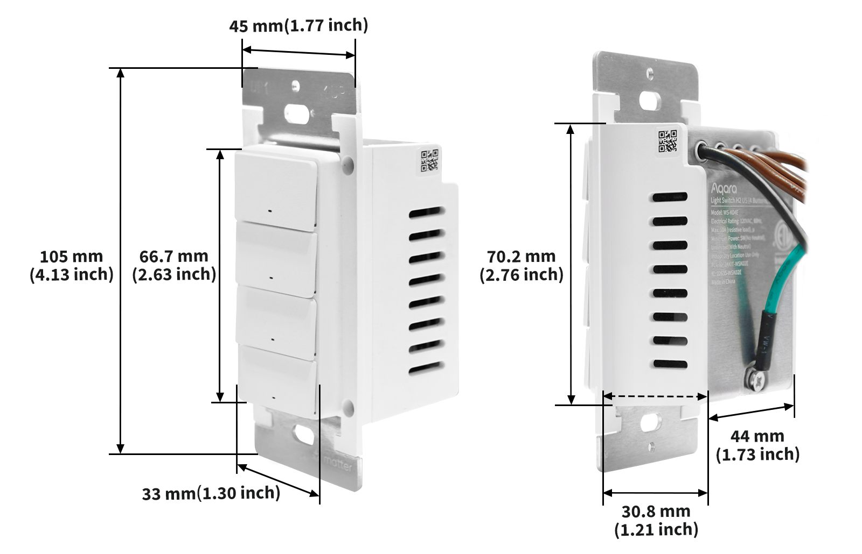
Installation
The product dimensions are 70.2×44.0×30.8mm (2.76 × 1.73 × 1.21 in.), and the recommended cassette dimensions are greater than 3 inches (75mm) in length, greater than 2 inches (50.8mm) in width, and greater than 2-1/8 inches (54mm) in depth.

Slide 15
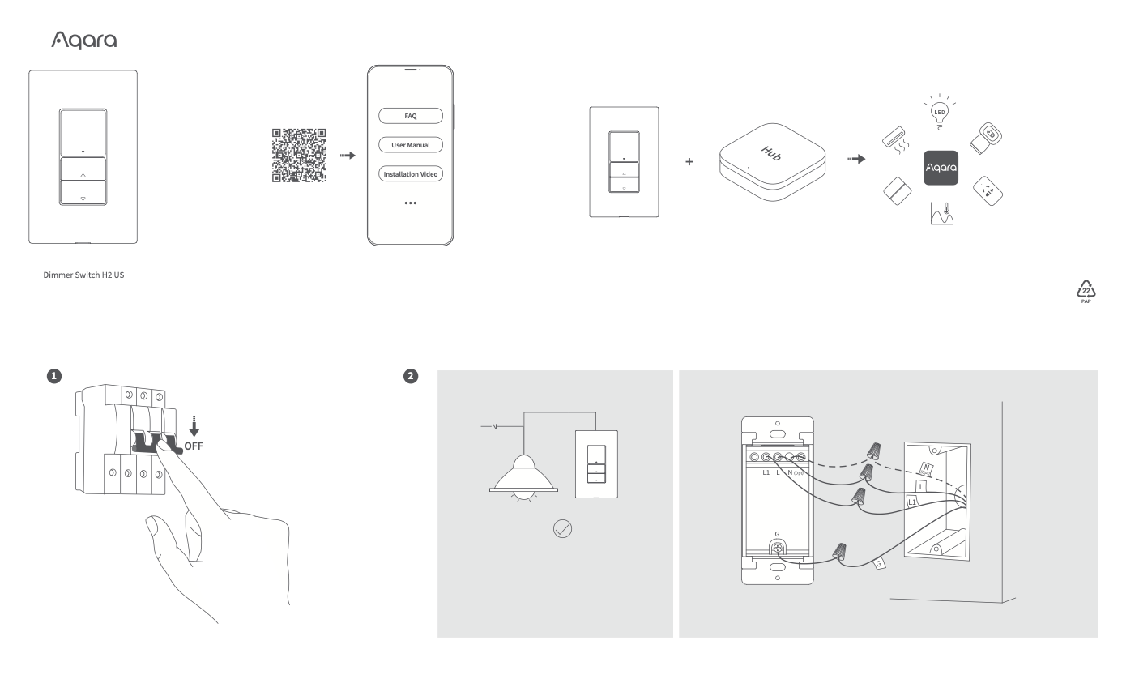
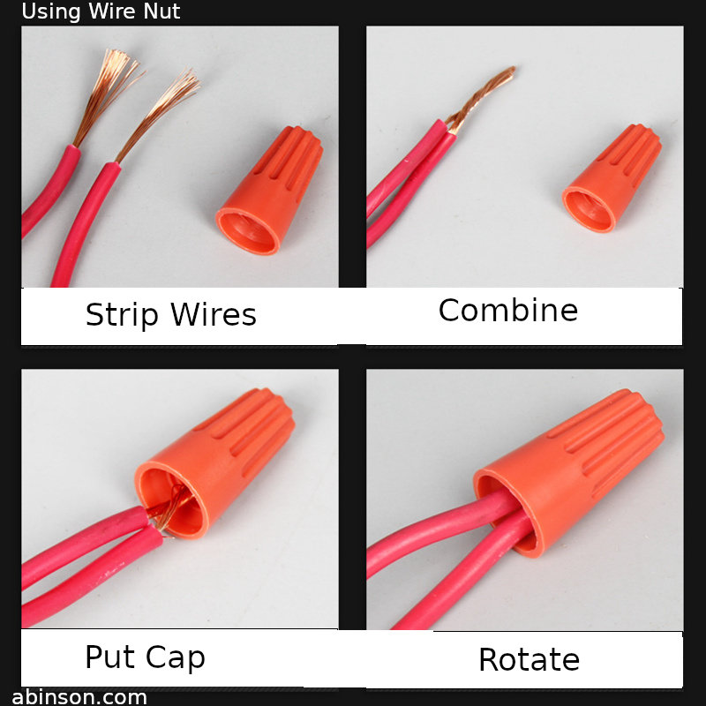
Installation

Slide 16
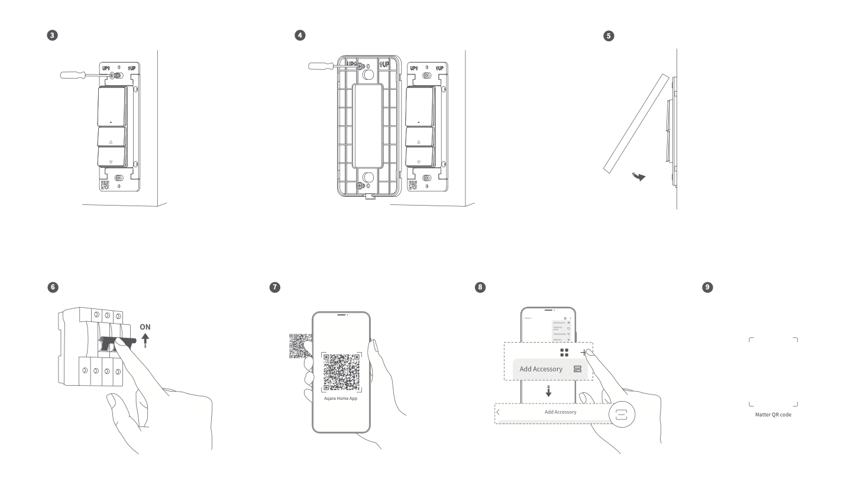
Installation

Slide 17
Content
Product Introduction
Product Installation
Configuration on App
FAQ

Slide 18
Quick Setting
Using devices in a specific Matter ecosystem (Thread mode)
Requires the Matter controller and Thread border router of that ecosystem
1) Double-click the ON/OFF button, then hold it for 5 seconds until the green indicator light starts flashing, indicating that the device has entered network configuration mode.
2) Open an app that supports Matter, scan the Matter code in the manual or on the product, or enter the setup code to add the device to the app.
3) Follow the app instructions to complete the operation.
Using devices in Aqara Home (Thread mode) Requires an Aqara gateway with border router function (such as Hub M3)
1) Double-click the ON/OFF button, then hold it for 5 seconds until the green indicator light starts flashing, indicating that the device has entered network configuration mode.
2) In the Aqara Home app, click "Add accessories", select Dimmer Switch H2 US, scan the Matter code in the manual or on the product, or enter the setup code to add the device to the app, and select Thread on the "Switching protocol" page.
3) Follow the app instructions to complete the operation.
Using the device in Aqara Home (Zigbee mode) Requires an Aqara Zigbee gateway (such as Hub M3)
1) Double-click the ON/OFF button, then press and hold for 5 seconds until the green indicator light starts flashing, indicating that the device has entered network configuration mode.
2) In the Aqara Home app, click "Add Accessory", hold your phone close to the device, and Dimmer Switch H2 US will be displayed on the top left of the app. Click the icon and select Zigbee on the "Switch Protocol" page.
3) Follow the app instructions to complete the operation.

Slide 19
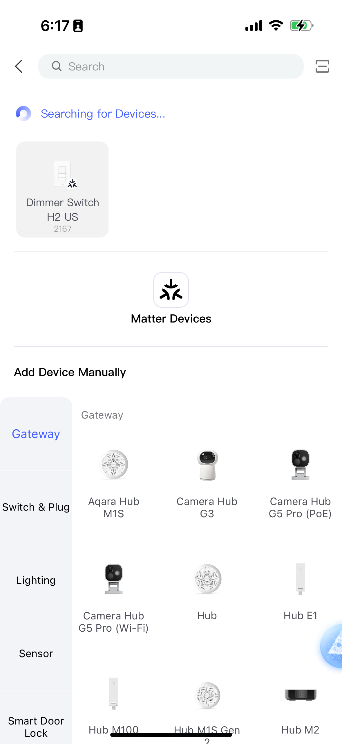
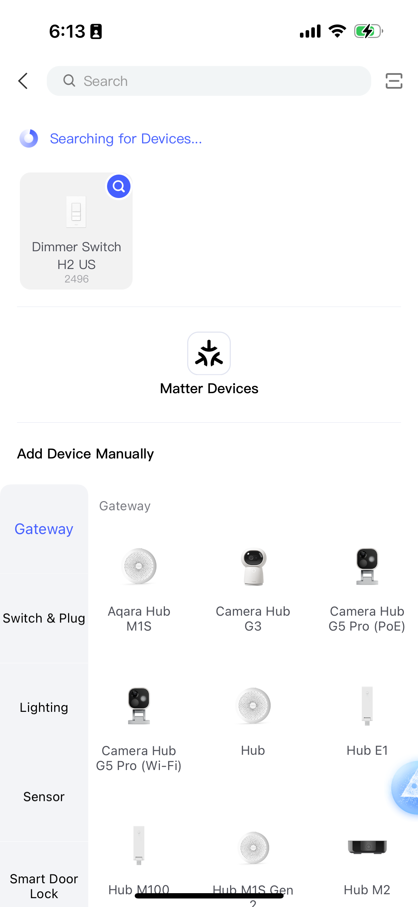
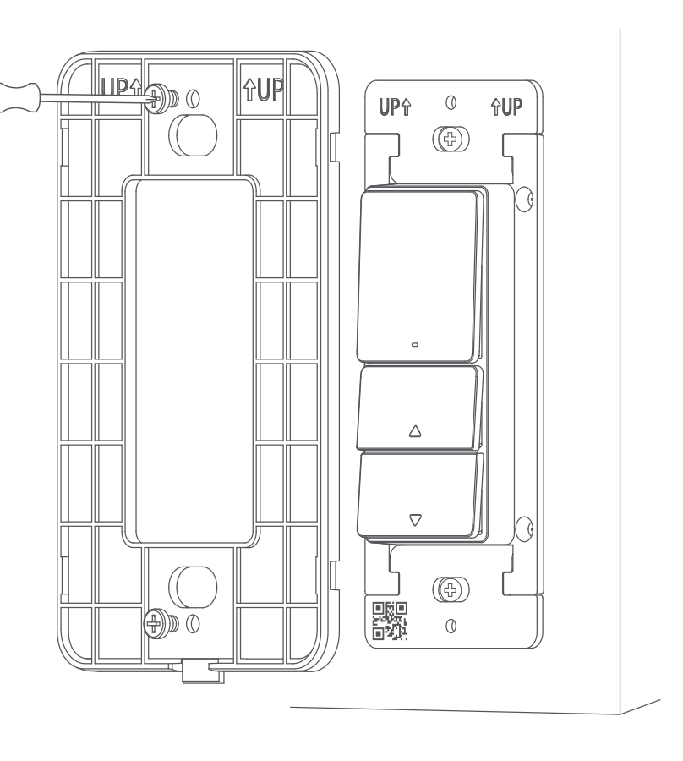
Binding
Matter mode(default)
Zigbee mode

Slide 20
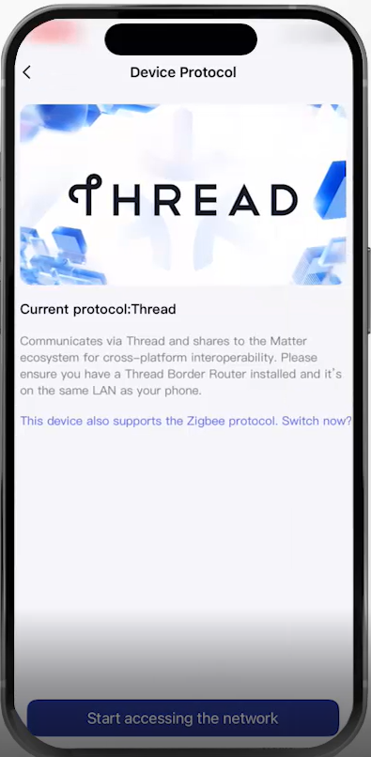
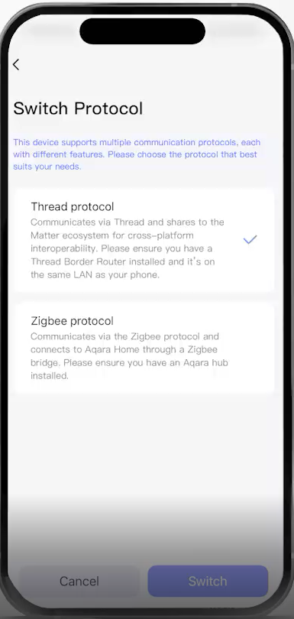
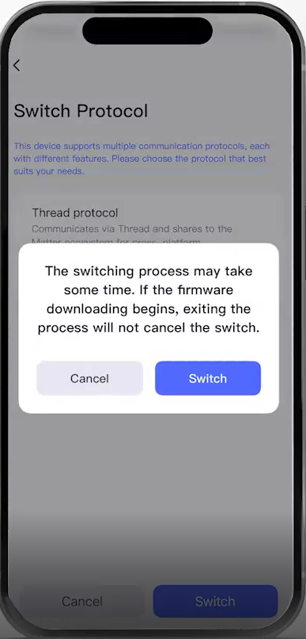
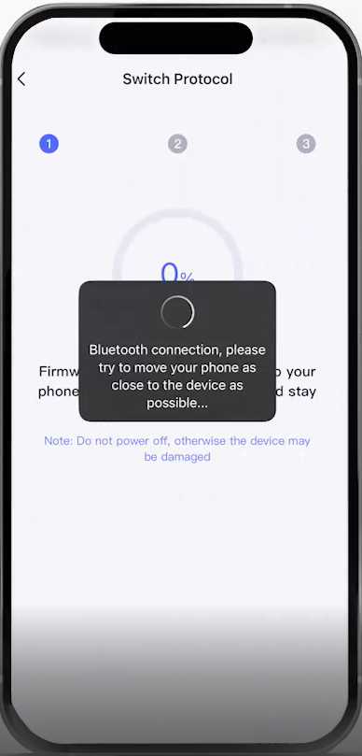
Dual protocol switching
Click Add Device in the Aqara home app, then scan the Matter QR code under the device button. Select Switch Protocol on the network access interface and select the protocol type you need. Wait for the device to switch protocols.

Slide 21
Key interaction
Button Operations | Description
Single-click the switch button. | On/off
Single-click the dimming + or dimming - button. | Default 10% step dimming
Double-click the dimming +/- button. | Adjust the light to the brightest/darkest
Press and hold the dimming +/- button. | Linearly adjust the brightness to the brightest or darkest
Enter the minimum brightness configuration mode within 3 seconds after double-clicking the switch button. After reaching the desired brightness by adjusting the button, click the switch button to save the setting. The setting success indicator flashes green twice slowly | Minimum brightness setting
Click the switch button 5 times to enter the phase selection mode. After entering this mode, the yellow light flashes three times slowly. Red means the current mode is the front phase. Click toggle. Green means the current mode is the rear phase. Long press to save and exit. It will automatically exit after timeout. The timeout duration is 1 minute. | Phase cut setting
Press and hold for 5 seconds within 3 seconds after double-clicking the switch button. | Reset device
Quickly press the switch button 10 times. | Restore factory settings

Slide 22
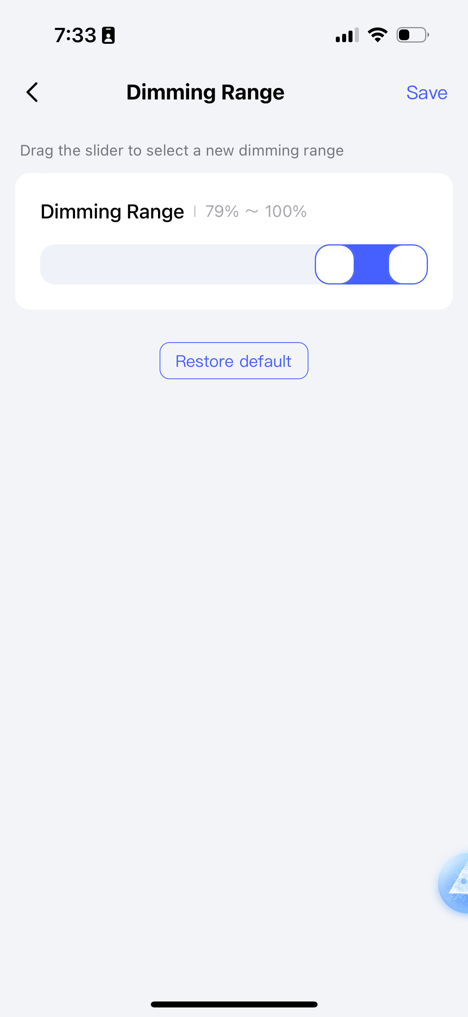
Brightness Adjustment
Why do you need to set the minimum brightness, and how do you set it? (Zigbee/Matter)
Setting a minimum brightness level helps avoid issues such as flickering, buzzing, or reduced bulb lifespan. These problems can occur if the bulb operates near or below its minimum power threshold. Additionally, some low-power lamps may show little or no noticeable change in brightness at very low levels.
To set the minimum brightness:
Method 1:
Double-click the ON/OFF button. Within 3 seconds, press the dimming △/▽ button to adjust to the desired minimum brightness. Press the ON/OFF button again to confirm and save the setting.
Method 2 (Zigbee only):
You can also set the minimum brightness via the Aqara Home app on the Zigbee protocol settings page.
Why do you need to set the maximum brightness, and how do you set it? (Zigbee)
Limiting the maximum brightness prevents low-power lamps from being pushed to their limits, which could cause the controller to draw insufficient power. This may lead to noticeable flickering or even operational failure.
Note: This feature is not supported under the Thread protocol (Matter).
How to set: You can configure the maximum brightness via the Aqara Home app under the Zigbee protocol settings.
Zigbee

Slide 23
Lighting Interaction
Color | Status | Description
Green | Fast flashing | Device power on/device pairing/device search (Thread)/device deletion
Green | Slow flashing | Network connection in progress
Green | Super slow flashing | Pairing successful/switch to reverse dimming mode
Red | Fast flashing | Device offline
Red | Slow flashing | Device overheating/overload
Red | Super slow flashing | Pairing timeout/switch to forward dimming mode
Yellow | Fast flashing | Device search (Zigbee)
Yellow | Slow flashing | Phase dimming mode selection

Slide 24
Content
Product Introduction
Product Installation
Configuration on App
FAQ

Slide 25
FAQ
1. What types of loads (light bulbs) can be used?
The device supports dimmable LEDs, dimmable CFLs, incandescent and halogen bulbs, and can also be used with magnetic low voltage (MLV) loads. Please use LED and CFL bulbs marked with DIMMABLE on the package.
2. Is a neutral wire required?
The device supports with-neutral and no-neutral wiring, and whether a neutral wire is required can be determined based on the circuit.
3. When adding a device, how can I find the current protocol of the device?
During pairing, when the indicator light flashes green, it means that the Thread protocol is being used; when the indicator light flashes yellow, it means that the Zigbee protocol is being used.
4. What are the load ratings for different light bulbs?
Incandescent bulbs or halogen bulbs ≤ 360W, dimmable LED or dimmable CFL ≤ 240W, MLV ≤ 240W.
5. After replacing the LED bulb, why is there no light when I turn it on at the lowest brightness?
Some LED bulbs are more sensitive than others and require a higher voltage to turn "on." To address this, the minimum brightness can be adjusted to optimize the brightness of the LED bulb.
6. Why do some LED bulbs seem to have a slight delay before turning on?
If the device has a light on/off transition time turned on, it can make the light fade out or light up gradually instead of turning it on and off instantly like a regular switch.

Slide 26
FAQ
7. How to switch between leading edge dimming and trailing edge dimming?
Click the ON/OFF button 5 times to enter the phase selection mode. After entering this mode, the yellow light will flash slowly three times. The red color indicates that the current mode is the leading edge dimming mode, and the green color indicates that the current mode is the trailing edge dimming mode. Click the ON/OFF button to switch. After setting, long press the ON/OFF button to save and exit. The system will automatically exit after the timeout. The timeout period is 1 minute.
8. How to choose between leading-edge dimming and trailing-edge dimming?
Magnetic low voltage (MLV) loads only support leading edge dimming; incandescent bulbs, halogen bulbs, dimmable LEDs, and dimmable CFLs support leading edge or trailing edge dimming. You can choose the phase-cut mode with the better dimming effect based on the actual performance of the bulb.
9. How to set minimum brightness?
Double-click the ON/OFF button, and within 3 seconds, click the dimming △/▽ button to adjust to the appropriate brightness, then click the ON/OFF button to confirm and complete the setting. You can also set it through the Aqara Home settings page under in the Zigbee protocol.
10. How do I set the maximum brightness?
Currently, this function is not supported in the Thread protocol. It can be set using the Aqara Home settings page in the Zigbee protocol.
11. Why do we need to set a minimum brightness?
Prevents lights from flickering, failing to emit a stable light, or failing to start at low brightness.
12. What issues could occur if the minimum brightness is set too low?
Setting it too low may cause flickering and humming, and operating the bulb close to its minimum threshold may shorten its life.
Switch Protocols

Slide 27
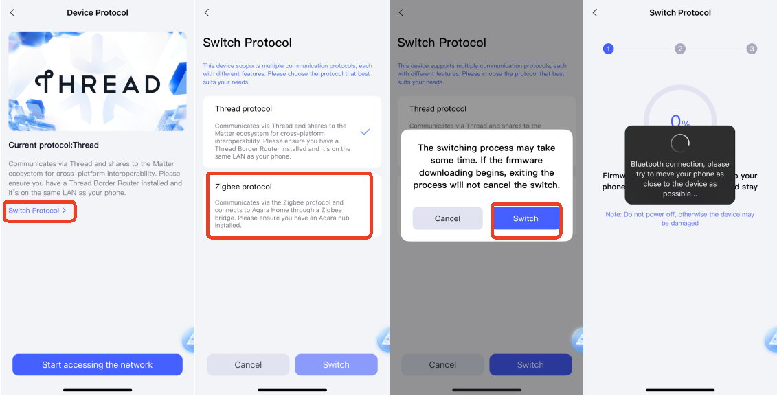
FAQ
13. Why do I need to set a maximum brightness?
This prevents low-power bulbs from flickering noticeably or even failing to work properly due to insufficient power drawn by the device when the bulb reaches its maximum brightness.
14. Are non-dimmable bulbs with the required wattage supported?
When connecting to this type of bulb, you can only control the ON/OFF function, but cannot adjust the brightness of the bulb.
15. How to switch from Thread protocol to Zigbee protocol?
1) Install the Aqara Home app and enable Wi-Fi and Bluetooth.
2) Restore the device to factory settings (press the ON/OFF button 10 times in a row) to enter the pairing mode (it will automatically enter pairing mode when adding a device for the first time), and the indicator light will flash slowly.
3) In the Aqara Home app, tap "Add Accessory," bring your phone close to the device, and the Dimmer Switch H2 US icon will appear at the top left of the app. Tap the icon and select Zigbee on the "Switch Protocol" page, then follow the app’s instructions to complete the setup
16. How to switch from Zigbee protocol to Thread protocol?
1) Install the Aqara Home app and enable Wi-Fi and Bluetooth.
2) Restore the device to factory settings (press the ON/OFF button 10 times in a row) to enter the pairing mode (it will automatically enter pairing mode when adding a device for the first time), and the indicator light will flash slowly.
3) In the Aqara Home app, tap "Add Accessory," bring your phone close to the device, and the Dimmer Switch H2 US icon will appear at the top left of the app. Tap the icon and select Thread on the "Switch Protocol" page, then follow the app’s instructions to complete the setup

Slide 28
FAQ
17. How do I restore factory settings?
Press the ON/OFF button 10 times in a row until the indicator light starts flashing (green: Thread mode, yellow: Zigbee mode) indicating that the device has been factory reset and has now entered into pairing mode.
18. How do I reset my device? Does removing the device from the app have the same result as resetting it?
First, double-press, then press and hold the ON/OFF button within 3 seconds. The indicator light will start flashing quickly to indicate a successful reset. Removing the device has the same result as resetting.
19. What is the difference between factory reset and resetting your device?
Resetting the device only clears the device's network configuration information, while other configuration settings are retained; a factory reset will clear the network information and configuration information and restore the device to its factory state.
20. What are the in-wall dimensions for the Dimmer Switch H2 US?
The product’s dimensions are 70.2×44.0×30.8mm (2.76 × 1.73 × 1.21 in.), and the recommended electric box dimensions are greater than 3 inches (75mm) in length, greater than 2 inches (50.8mm) in width, and greater than 2-1/8 inches (54mm) in depth.
21. Can the indicator lights be customized?
The indicator light can be customized through the Aqara Home app. By default, the indicator light is on when the light is on, and it is off when the light is off. It is not recommended to change the default configuration in single-pole mode; third-party Matter platforms are not currently supported.

Slide 29
FAQ
22. What is the default transition time for the lights to turn on or off after pressing the switch?
The default time is 500ms, and it allows adjustments within a range of 0-10s.
23. How to check which protocol you are on after pairing?
You can view the current device protocol on the device page > "..." in the upper right corner > "Communication Protocol"
24. What is the minimum load supported by the device?
The minimum load is 4W in Aqara Home and 9W using a third-party Matter platform.

Slide 30
FAQ
25. How do I connect the Dimmer Switch H2 US to my phone?
To connect the device to your phone, you will need to either connect it to an ecosystem of your choice through Matter, such as AppleHome, or connect it to the Aqara App.
Using devices in a specific Matter ecosystem (Thread mode)
Matter controllers and Thread border routers for this ecosystem are required:
1) Double-click the ON/OFF button and hold it for 5 seconds until the green indicator light starts flashing, indicating that the device has entered pairing mode.
2) Open a Matter-enabled app and scan the Matter code in the manual or on the product, or enter the setup code to add the device to the app.
3) Follow the app instructions to complete the setup.
Using devices in Aqara Home (Thread mode)
An Aqara hub with border router function (such as Hub M3) is required:
1) Double-click the ON/OFF button and hold it for 5 seconds until the green indicator light starts flashing, indicating that the device has entered pairing mode.
2) In the Aqara Home app, tap "Add Accessory", select Dimmer Switch H2 US, scan the Matter code in the manual or on the product, or enter the setup code to add the device to the app, and select Thread on the "Switch Protocol" page.
3) Follow the app instructions to complete the setup.
Using devices in Aqara Home (Zigbee mode)
Aqara Zigbee hub required:
1) Double-click the ON/OFF button, then press and hold it for 5 seconds until the green indicator light starts flashing, indicating that the device has entered pairing mode.
2) In the Aqara Home app, click "Add Accessory", hold your phone close to the device, and Dimmer Switch H2 US will be displayed on the top left of the app. Click the icon and select Zigbee on the "Switch Protocol" page.
3) Follow the app instructions to complete the setup.

Slide 31
THANK YOU

